Slide 1
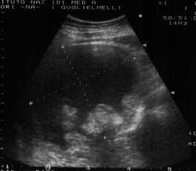
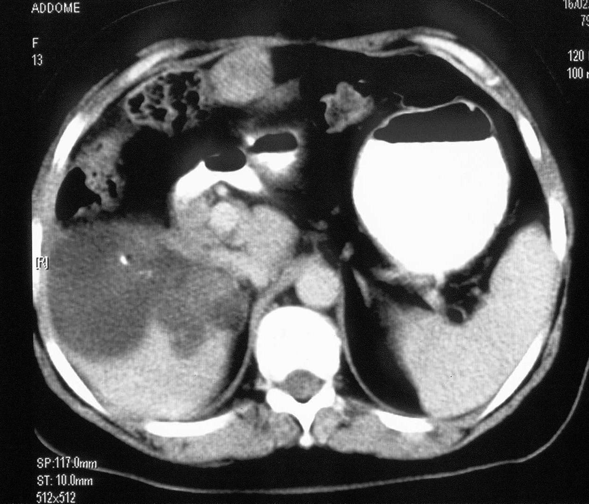
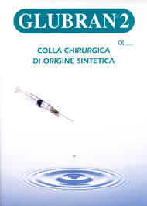
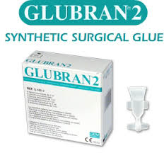
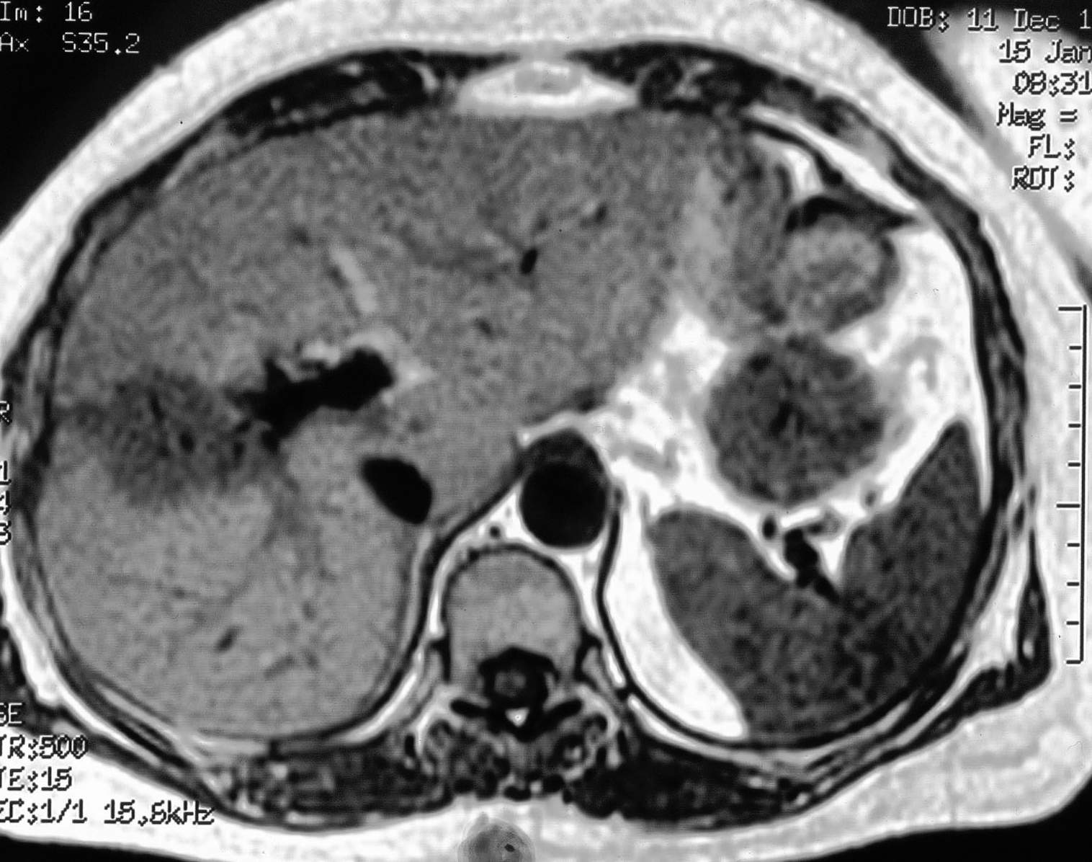
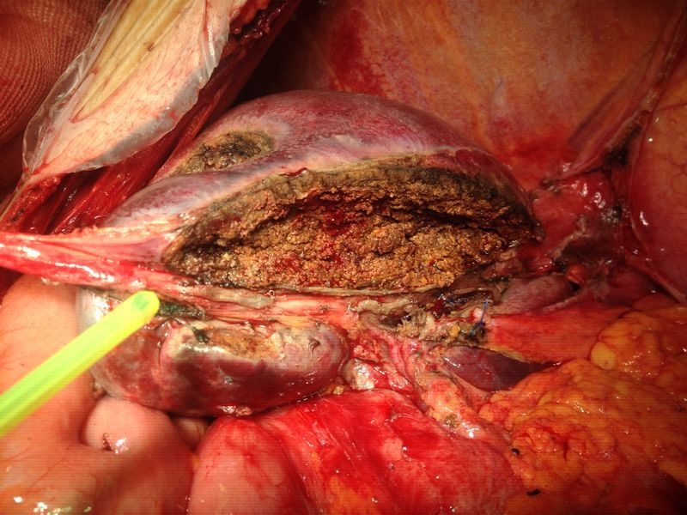
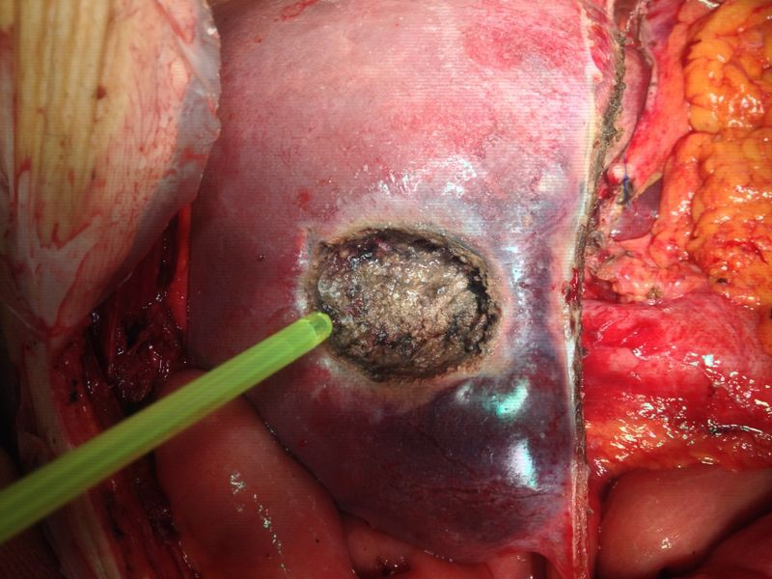
PREVENTION OF BILOMAS WITH CYANOACRYLATE-BASED SURGICAL GLUE, AFTER MAJOR LIVER RESECTION
Albino V , Palaia R , di Giacomo R , Amore A , Saponara R , Piccirillo M, Leongito M, Lastoria S*, Granata V*and Izzo F
Department of Abdominal Surgical Oncology - National Cancer Institute of Neaples
*Department of Nuclear Medicine - National Cancer Institute of Neaples
°Departmentof Radiology - National Cancer Institute of Neaples
Prupose: The " biloma " is an encapsulated collection of bile outside the biliary tree , supported by a predominantly iatrogenic biliary fistula . The incidence of bilomas post- hepatic resection is in the literature between 4-17 % . In addition, with the advent of neoadjuvant chemotherapy in combination with biologic drugs , the incidence of bilomas increased significantly , reaching between 16 and 42% . Patients with post-operative bilomas have a higher risk of severe complications (54.3% vs 29.2% , P = 0.002 ) , a prolonged postoperative hospital stay (29 days versus 14 days , p < 0.001 ) and increase of post-operative mortality (8.6% vs . 2.6 % , P = 0.045 ) compared with patients without biliary fistula . Based on literature and our experience the key factor in biliostasis seems to be the adhesive ability of any substance to the liver resection surface .
We , therefore , hypothesized to apply on the hepatic resection area the cyanoacrylate glue ( Glubran 2 ) , that exhibits high adhesive capacity in order to reduce the formation of biliary fistulas . Glubran 2 is a surgical glue of synthetic origin, for indoor and outdoor use , with haemostatic, adhesives, sealants and bacteriostatic properties .
Materials and methods: in 2013 at the National Cancer Institute of Naples, we performed 95 major liver resections , including 63 for metastatic colorectal cancer who underwent neoadjuvant chemotherapy . In all patients the surgical glue (Glubran 2) was applied, on the hepatic resection surface.
Results: no type of complication, related to the use of Glubran 2, has been highlighted ; The incidence of bilomas was comparable to that reported in the literature (11 % ) and lower than 21 % incidence reported in our previous experience in the last two years
Conclusions: the use of Glubran 2 proved to be free from complications, and has significantly reduced the incidence of bilomas in our series .
References
Schepers A, Mieog S, van de Burg BB, van Schaik J, Liefers GJ, Marang-van de Mheen PJ (2010) Impact of complications after surgery for colorectal liver metastasis on patient survival. J Surg Res 164:e91–e97. doi:10.1016/j.jss.2010.07.022
Ito H, Are C, Gonen M et al (2008) Effect of postoperative morbidity on long-term survival after hepatic resection for metastatic colorectal cancer. Ann Surg 247:994–1002
Yamashita, Yo-ichi MD; Hamatsu, Takayuki MD; Rikimaru, Tatsuya MD; Tanaka, Shinji MD; Shirabe, Ken MD; Shimada, Mitsuo MD, and; Sugimachi, Keizo MD, FACS. Bile Leakage After Hepatic Resection. Annals of Surgery; January 2001 - Volume 233 - Issue 1 - pp 45-50.
Ryuji Yoshioka • Akio Saiura • Rintaro Koga • Makoto Seki • Yoji Kishi • Junji Yamamoto. Predictive Factors for Bile Leakage After Hepatectomy: Analysis of 505 Consecutive Patients. World J Surg (2011) 35:1898–1903 DOI 10.1007/s00268-011-1114-7
Lee CC et al. (2005). Risk factors associated with bile leakage after hepatic resection for hepatocellular carcinoma. Hepatogastroenterology. 2005 Jul-Aug;52(64):1168-71.
Rubbia-Brandt L et al (2004) Severe hepatic sinusoidal obstruction associated with oxaliplatin-based chemo- therapy in patients with metastatic colorectal cancer. Ann Oncol 15:460–466
Vauthey JN et al (2006) Chemotherapy regimen predicts steatohepatitis and an increase in 90-day mortality after surgery for hepatic colorectal metastases. J Clin Oncol 24:2065–2072.
Pawlik TM et al (2007) Preoperative chemotherapy for colorectal liver metastases: impact on hepatic histology and postoperative outcome. J Gastrointest Surg 11:860–868.
Makowiec F et al (2011) Chemotherapy, liver injury, and postoperative complications in colorectal liver metastases. J Gastrointest Surg 15(11):153–64.
Fernandez FG et al (2005) Effect of steatohepatitis associated with irinotecan or oxaliplatin pretreatment on resectability of hepatic colorectal metastases. J Am Coll Surg 200:845–853.
Robinson S M et al (2013) The potential contribution of tumour-related factors to the development of FOLFOX-induced sinusoidal obstruction syndrome. British Journal of Cancer 109, 2396–2403

